Slide 1

Smart cities
Technologies and their impact on human life
Nikolay Nikolaev

Slide 2
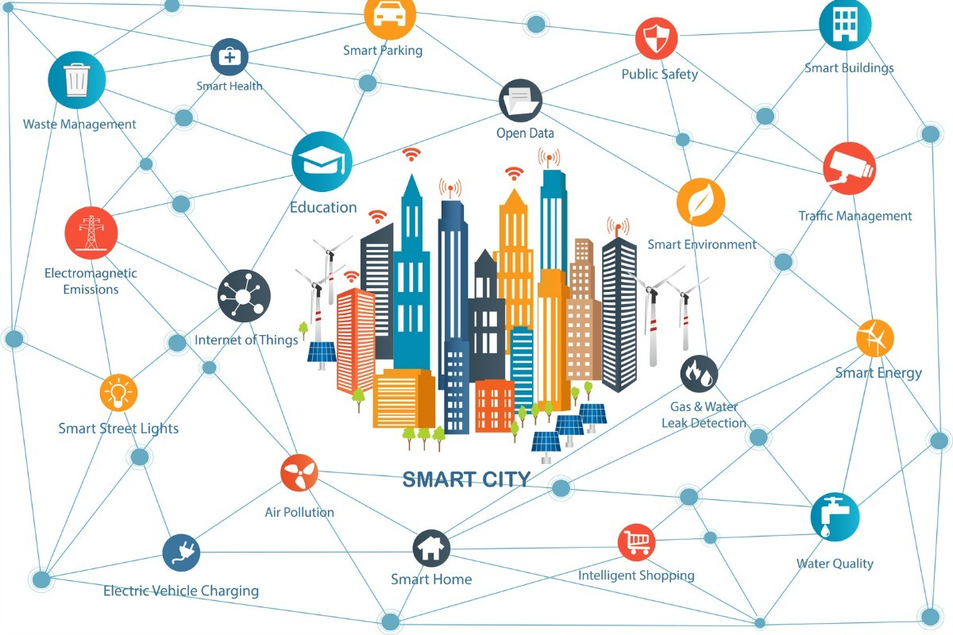
OVERVIEW
Uses different types of electronic data collection sensors
ICT
IoT

Slide 3
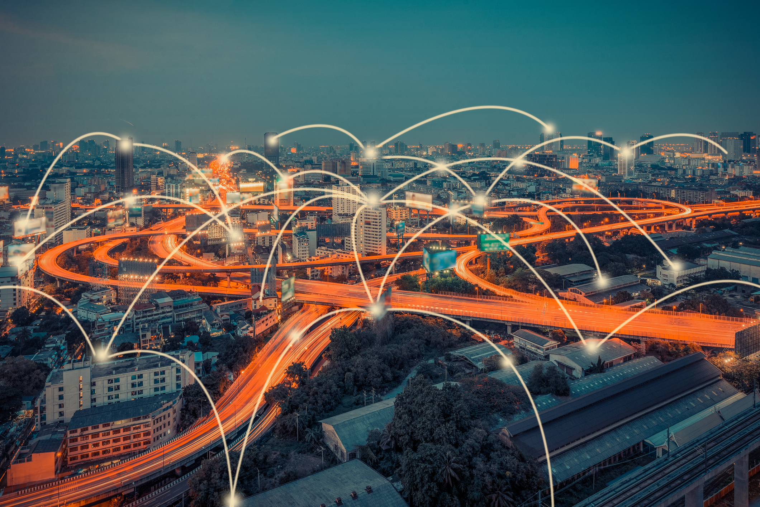
dEFINITION
Various definitions
Application of a wide range of electronic and digital technologies to communities and cities
Positively impacts the local community

Slide 4

WHY?
Reduce costs and resource consumption
Increase contact between citizens and government

Slide 5
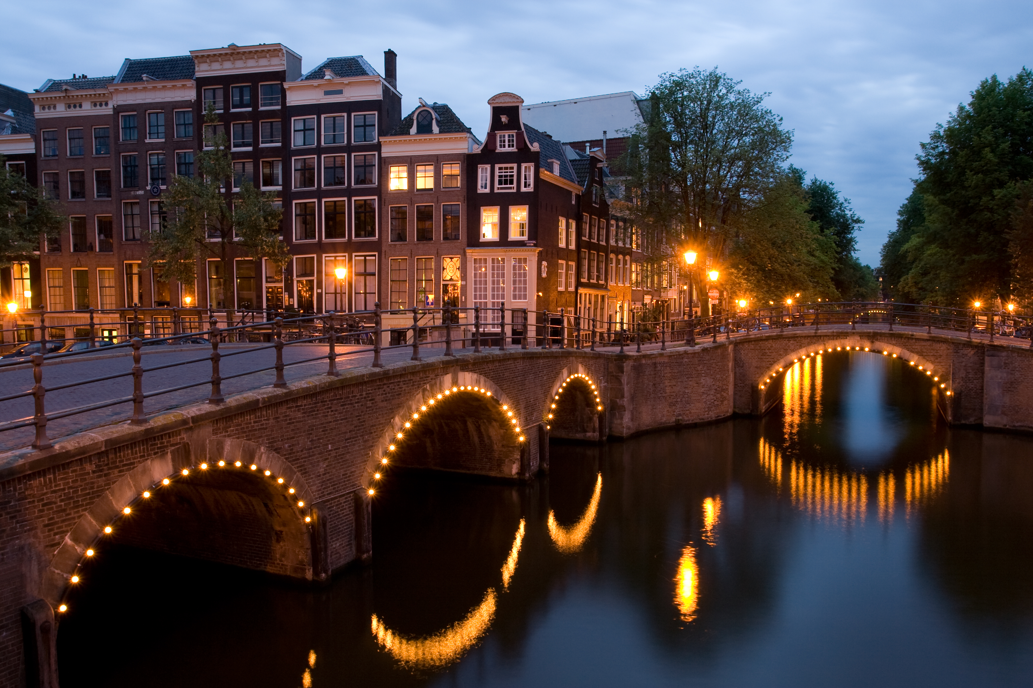
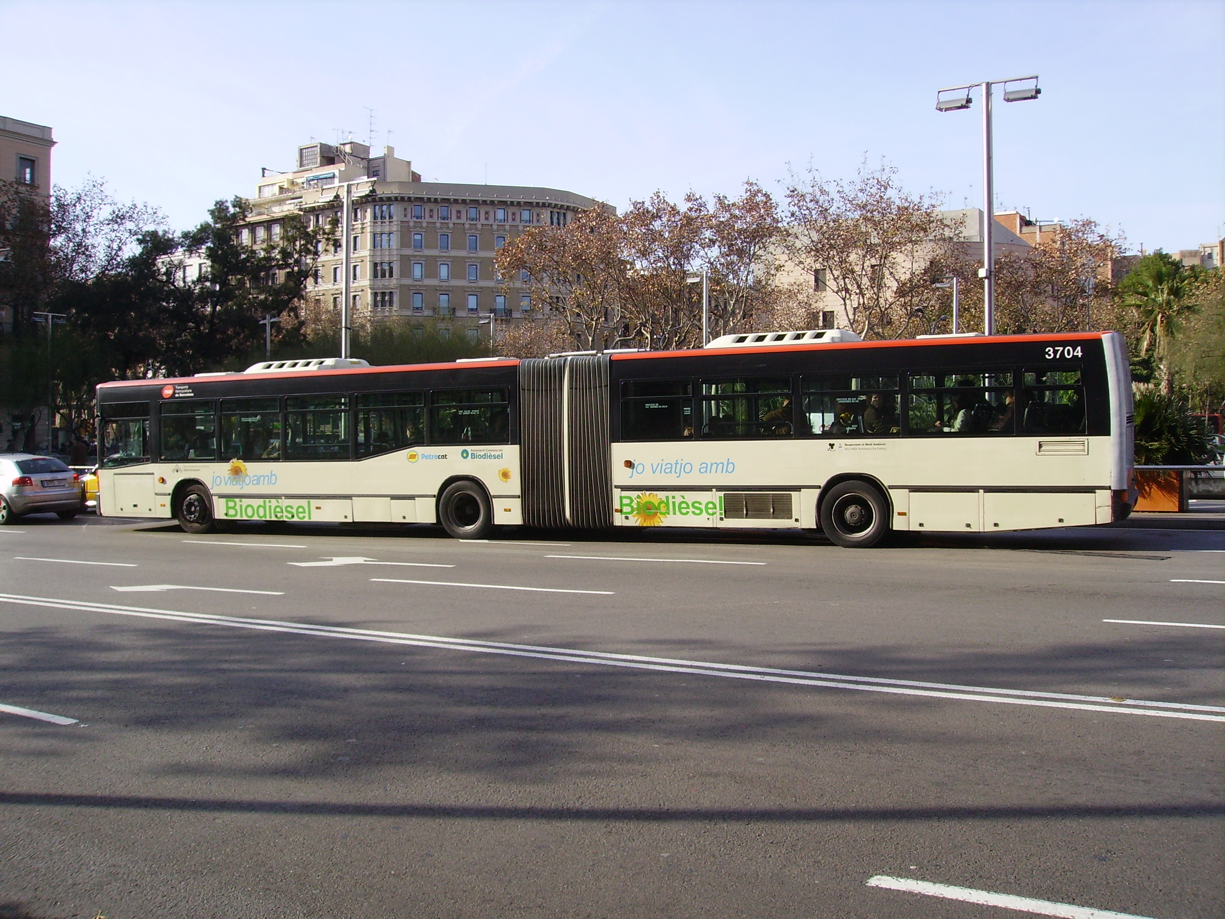

EXAMPLES
Columbus
Barcelona
Amsterdam

Slide 6


EXAMPLES
New York
Singapore

Slide 7

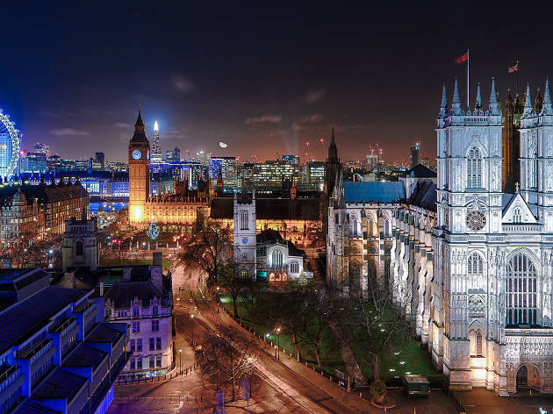
EXAMPLES
Oslo
London

Slide 8
EXAMPLES
Santa Cruz
San Leandro
Laguna Croatá
New Songdo City
Dublin
Stockholm
Manchester
Madrid
Milton Keynes
…and many more!

Slide 9
RECAP
Different implementations
Use of IoT
ICT
Positively impacts the local community
Smart energy, water and waste management

Slide 10



Thank YOU!
Nikolay Nikolaev
Find me on:
Facebook: fb.com/nknikolaeff
Instagram: instagram.com/nknikolaeff

